Slide 1
More sophisticated behavior
Using library classes to implement some more advanced functionality
5.0

Slide 2
Main concepts to be covered
Using library classes
Reading documentation

Slide 3
The Java class library
Thousands of classes.
Tens of thousands of methods.
Many useful classes that make life much easier.
Library classes are often inter-related.
Arranged into packages.

Slide 4
Working with the library
A competent Java programmer must be able to work with the libraries.
You should:
know some important classes by name;
know how to find out about other classes.
Remember:
we only need to know the interface, not the implementation.

Slide 5
A Technical Support System
A textual, interactive dialog system
Idea based on ‘Eliza’ by Joseph Weizenbaum (MIT, 1960s)
Explore tech-support-complete …

Slide 6
Main loop structure
boolean finished = false;
while(!finished) {
do something
if(exit condition) {
finished = true;
}
else {
do something more
}
}
A common iteration pattern.

Slide 7
Main loop body
String input = reader.getInput();
...
String response = responder.generateResponse();
System.out.println(response);

Slide 8
The exit condition
String input = reader.getInput();
if(input.startsWith("bye")) {
finished = true;
}
Where does ‘startsWith’ come from?
What is it? What does it do?
How can we find out?

Slide 9
Reading class documentation
Documentation of the Java libraries in HTML format;
Readable in a web browser
Class API: Application Programmers’ Interface
Interface description for all library classes

Slide 10
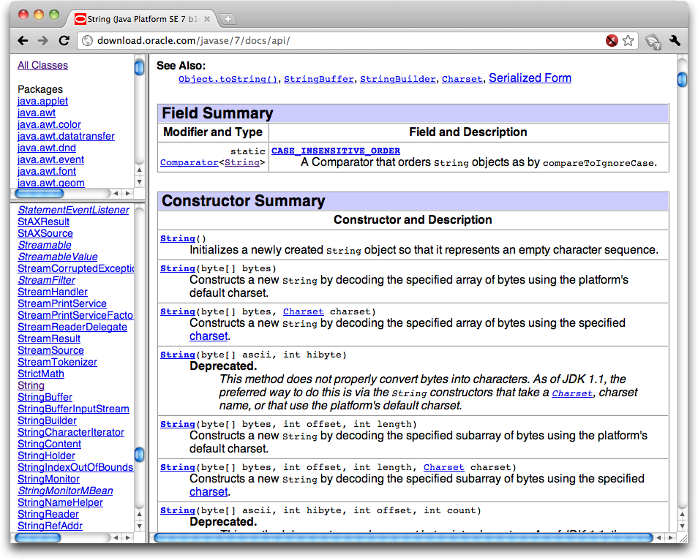

Slide 11
Interface vs implementation
The documentation includes
the name of the class;
a general description of the class;
a list of constructors and methods
return values and parameters for constructors and methods
a description of the purpose of each constructor and method
the interface of the class

Slide 12
Interface vs implementation
The documentation does not include
private fields (most fields are private)
private methods
the bodies (source code) of methods
the implementation of the class

Slide 13
Documentation for startsWith
startsWith
public boolean startsWith(String prefix)
Tests if this string starts with the specified prefix.
Parameters:
prefix - the prefix.
Returns:
true if the …; false otherwise

Slide 14
Methods from String
contains
endsWith
indexOf
substring
toUpperCase
trim
Beware: strings are immutable!

